Slide 1

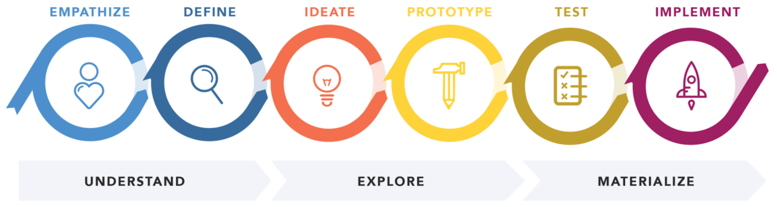
Narrowing down the problem with design thinking
https://hpi-academy.de/
Problem
Solution

Slide 2
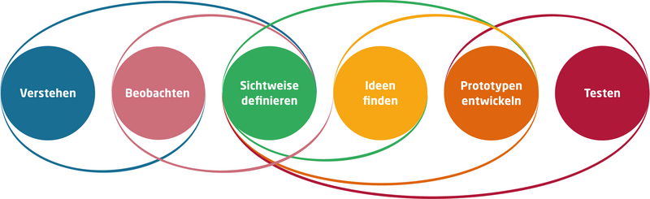

Observe/ Empathize
Getting to know and understand the stakeholders.
Who is actually our customer/user?
Notes:
What is the main problem you want to address and why is it important?
For whom is it a problem?
What social/cultural factors shape this problem?
What evidence do you have that it is worth investing in?
Can you think of a way to do it? Can you reframe it?

Slide 3
Why define a target group?
Every customer is looking for an individual product that meets their needs/wants.
Not every product appeals to everyone (design, does not meet needs)
Criteria frequently used for target group segmentation:
Demographic (place of residence, age, marital status, gender...)
Purchasing behavior (price sensitivity, media usage...)
Socioeconomic (level of education, occupation, income...)
Psychographic (attitudes, beliefs, desires, values, lifestyle...)

Slide 4
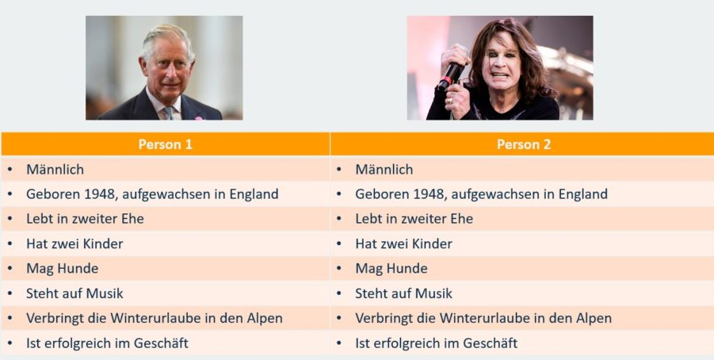
Target group vs. Persona
What does Prince Charles have in common with Ozzy Osborne?!?

Slide 5
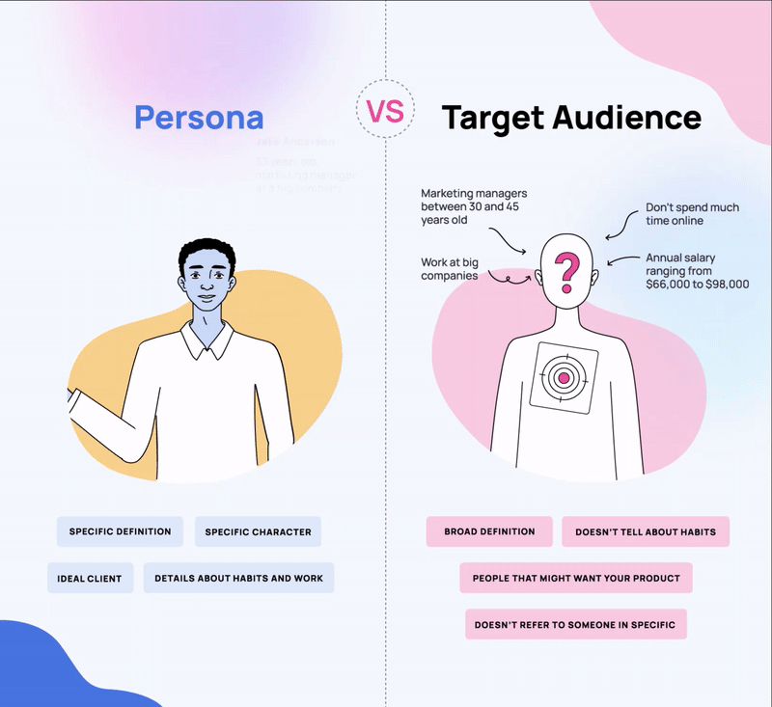
Target group vs. Persona
needs
desires
pains
gains
goals
feelings
etc.
age
financial situation
religion
gender
lifestyle
consumer preferences
hobbies/interests

Slide 6
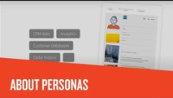
About Personas and how to create them
https://youtu.be/GNvLpfXCge8

Slide 7
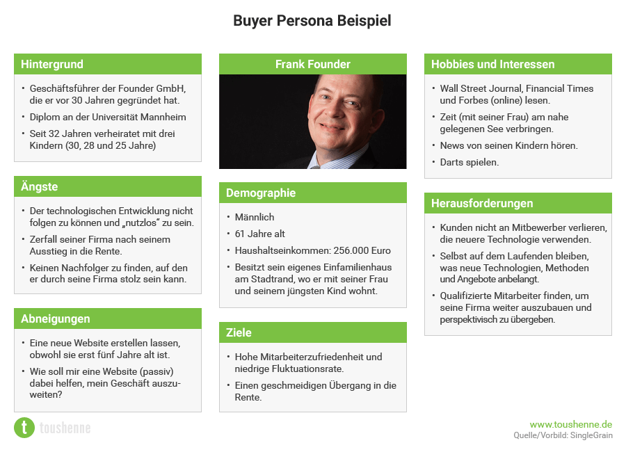
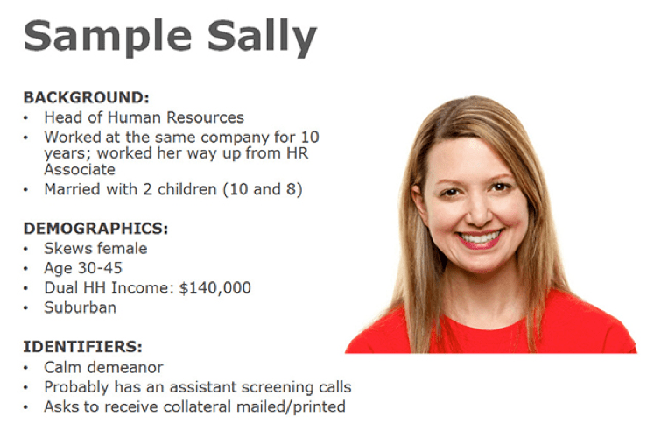
Ideation Phase: Persona
First create at least two personas in your team. Please do not describe yourself. Think outside the box. Who could need or use your solution?
What is their background? What are their interests? What challenges do the face and what aims do they have?
Use the template in your class course.

Slide 8
Ideation Phase: EMPATHY MAP
Start with the GOAL section, by defining WHO will be the subject of the Empathy Map and a goal: something they need to DO. This should be framed in terms of an observable behavior.
Once you have clarified the goal, work your way clockwise around the canvas, until you have covered Seeing, Saying, Doing, and Hearing. The reason for this is that the process of focusing on observable phenomena (things they see, say, do and hear) is like walking a mile in their shoes. It gives us a chance to imagine what their experience might be like, to give us a sense of what it “feels like to be them.”
Only AFTER you have finished the outer cycle you focus on what is going on in your persona‘s head.
Add your personas and empathy map to your project roadmap.

Slide 9
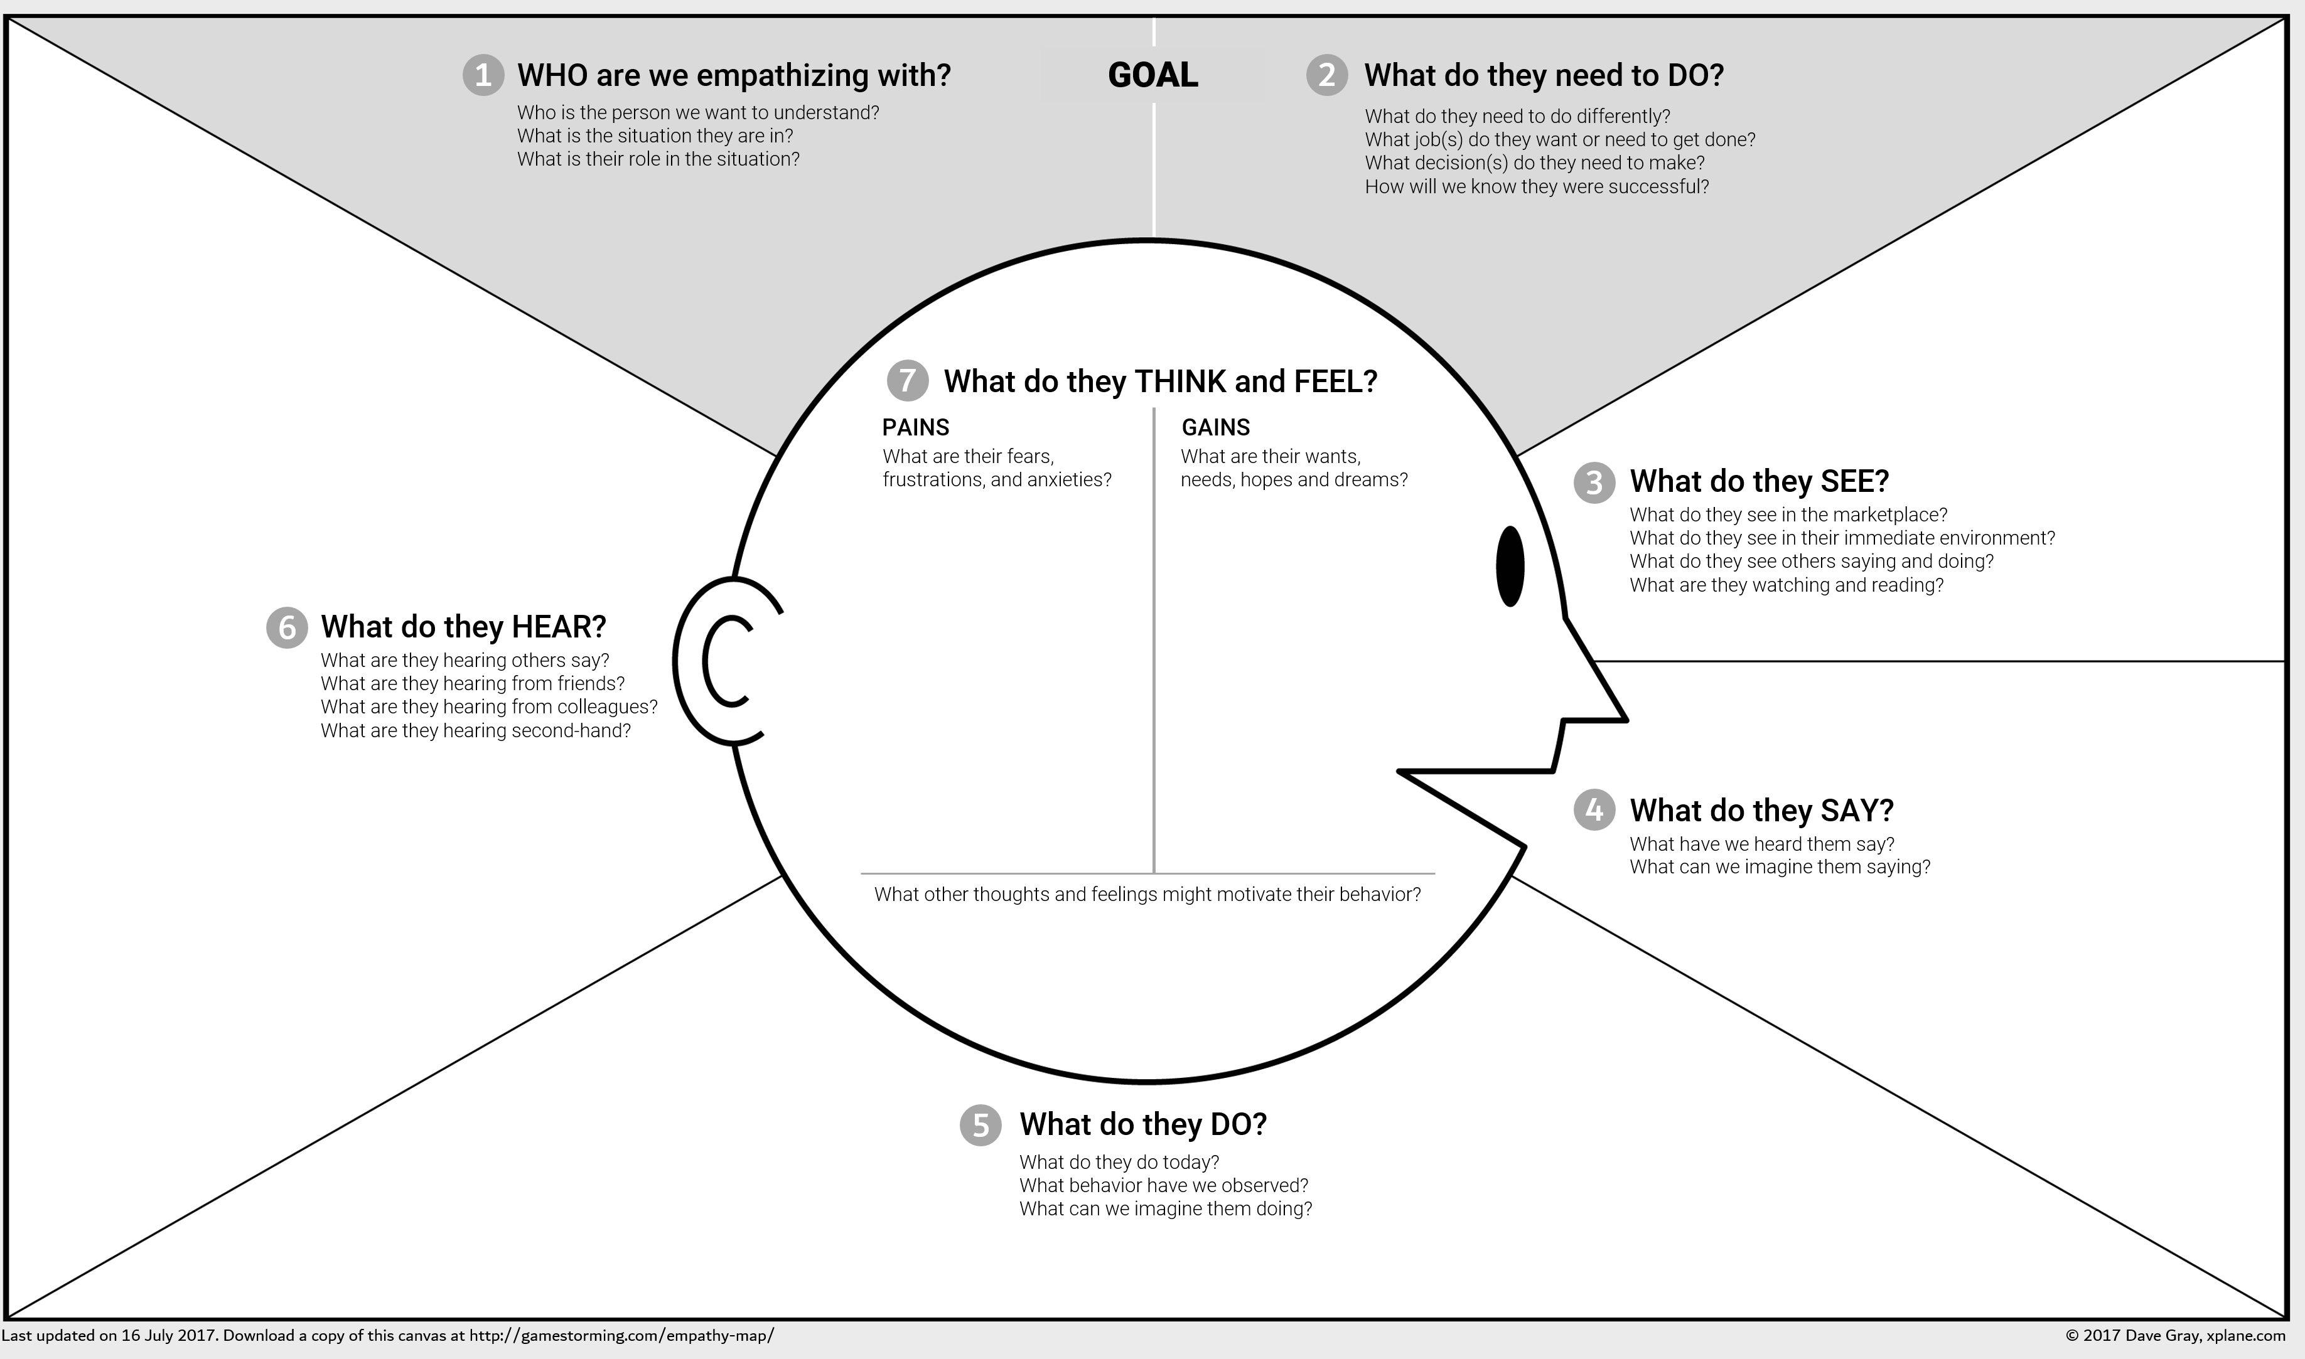
Ideation Phase: EMPATHY MAP

Slide 10
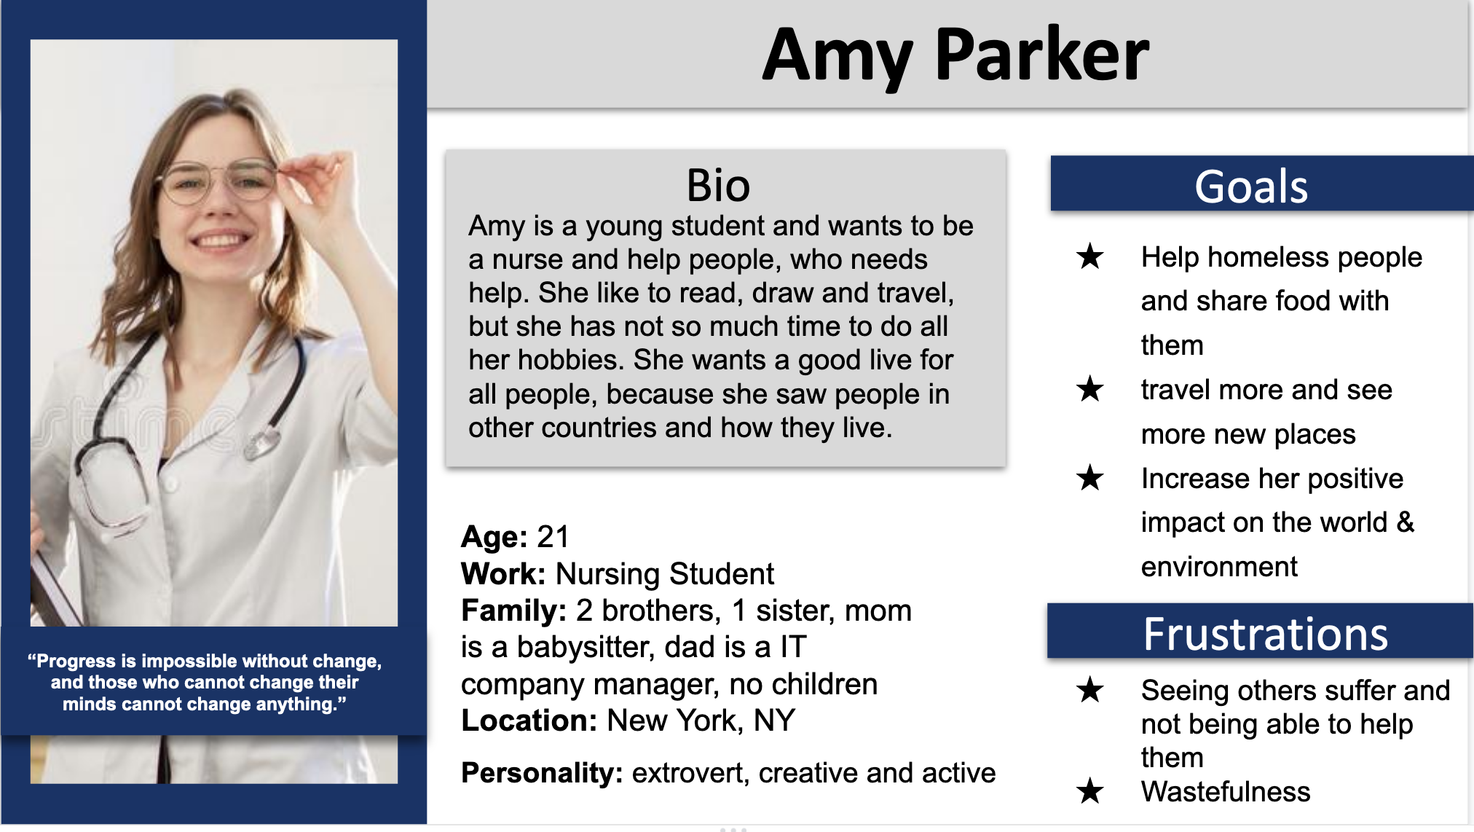
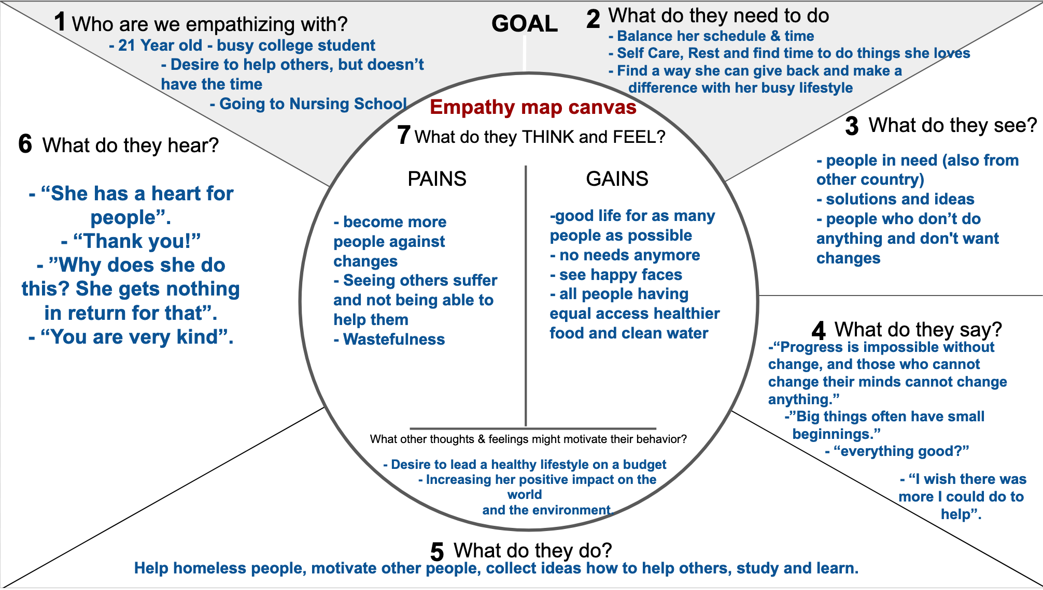
Define your problem examples
Sprint 1

Slide 11

Get started and have fun!

